Slide 1
Creative Coding 2
Statistical Graphics I

Slide 2
Data visualisation is described by the American psychologist and statistician Michael Friendly in his text Visualising Categorical Data as “an approach to data analysis that focuses on insightful graphical display. The word ‘insightful’ suggests that the goal is (we hope) to reveal some aspects of the data that might not be perceived, appreciated or absorbed by other means. The overall aims include both beauty and truth, though each of these is only perceived by the beholder”.

Slide 3
Overview
In this lecture we will review a sample of the of the range of statistical graphics that are currently available for visualising information.
The emphasis will be on the use of static (not interactive) or presentation graphics used primarily to communicate the results of data analysis.

Slide 4
Section 1
Graphical Methods Examples

Slide 5
1. Introduction

Slide 6
There are a wide range of graphical techniques that can be used to communicate the results of data analysis.
In this lecture, a number of graphical methods will be introduced – some will probably be familiar to you and some which you might not have met before.
Note that since several graphics can be used to display the same information, we will outline the advantages and disadvantages of each technique.

Slide 7
Some graphics are available through standard applications like EXCEL, whereas others require more specialised software such as Tableau.
Some even need to be drawn using a drawing package such as Adobe Illustrator.

Slide 8
2. Data Types

Slide 9
A common mistake in data design is to place all the emphasis on the visual layout, and ignore your data.
This leads to graphics that lack context and provide little value.
Before we can attempt to make choices about what graphics to choose, it is useful to categorise the data.
We will look at two common statistical classifications.

Slide 10
Discrete versus Continuous Data
Graphics can be divided into those that are more appropriate for discrete data and those that are suitable for presentation of continuous data.
Therefore one step towards designing an appropriate graphic for your data can be to determine if the data to be visualised are discrete or continuous.

Slide 11
Discrete Data
Discrete data has a limited number of distinct possible values or categories.
i.e. reject/accept, yes/no/maybe, sick/well, on/off etc.
Discrete data can also be described as data that can be measured precisely.

Slide 12
One way of obtaining discrete data is by counting.
For example:
The no. of components produced from an assembly line over a number of consecutive shifts: 45, 51, 44, 44, 43,… etc.

Slide 13
Discrete data can also be obtained from situations where counting is not involved.
For example:
Shoe sizes of a sample of people: 7, 10, 4½, 9…etc.

Slide 14
A particular characteristic of discrete data is the fact that possible data values progress in definite steps, i.e. shoe sizes are measured as 4 or 4½ etc., or there are 1 or 2 or 3 etc. people.

Slide 15
Continuous Data
Continuous data has a large number of possible values.
i.e. the weights or heights of people, times taken to do a particular task in minutes.
The most significant characteristic of continuous data is the fact that they cannot be measured precisely; their values can only be approximated to.
Examples are dimensions (lengths, heights), weights, areas and volumes, temperatures, times.

Slide 16
How well continuous values are approximated to, depends on the situation and the quality of the measuring instrument.
It might be adequate to measure people’s heights to the nearest inch, whereas spark plug end gaps would need to be measured to perhaps the nearest tenth of a millimeter.
Time card punching machines only record times in hours and minutes while sophisticated process control computers, dealing with volatile chemicals, would need to measure both time and temperature very finely.

Slide 17
Although continuous values cannot be identified exactly, they are often recorded as if they were precise and this is normally acceptable.
For example:
Clock-in times of the workers on a particular shift: 8:23, 8:28, 8:32,…etc.

Slide 18
Discrete or Continuous?
The number of male and female policyholders in an insurance companies portfolio.
The lengths of 100 computer components (in mm) inspected at an incoming audit station.
The arrival times into work of 1000 employees in a large corporation.
Weekly wages for a set of workers: 121.45, 162.85, 133.37,…etc.
Weights (in gm) of the contents of a selection of cans of baked beans: 446.8, 447.0, 446.8, 447.2,…etc.
The number of days missed by employees of a small Tech Company over a 6 month period.
Notes:
Discrete
Continuous
Continuous
Discrete
Continuous
Discrete

Slide 19
Univariate, Bivariate or Multivariate Data?
The next step in the selection of the appropriate graphic is to determine if the data set can be described as univariate, bivariate or multivariate.

Slide 20
Definition
Univariate data contains just one variable in the data set while bivariate contains two variables.
Multivariate data is comprised of sets with more than two variables.

Slide 21
Example
Consider a data set which contains the age of all patients undergoing treatment for a particular disease in a Dublin hospital.
The only variable in this data set is age of patient so this data is univariate.
If in addition to the age of the patient, the number of days treatment they have received is also included in the file, then the data is bivariate.
If the diagnosis and gender of each patient is added to the file, then the data set is multivariate as it contains four variables – age, number of days treatment, diagnosis and gender.

Slide 22
Numeric vs Non-numeric
Another obvious way of categorising data is numeric versus non-numeric.
All non-numeric variables are discrete.
Note that there are other ways of categorising data which we will mention later on in the module.

Slide 23
3. Visualisation of Univariate Data

Slide 24
1. Continuous Data (Univariate)
Histograms are one of the most common graphics used for representing univariate continuous data.
A histogram is a plot of the number of observations in a particular interval.
Histograms allow us to observe the general shape (or distribution) of the data and identify if any extreme points exist in the data set, which many otherwise remain hidden amongst the large amount of raw numbers.

Slide 25
Outliers
These extreme points (also known as outliers) may be the result of an error in recording a value, equipment malfunction etc., or may indicate the presence of special variation in our data set.
Whatever the reason, extreme or unusual data points should be investigated, and a decision taken whether to include them or not in the calculation of summary statistics.

Slide 26
Example
The number of hours spent per week watching TV reported by 50 respondents to a survey is shown in Table 1 on the following slide.

Slide 27
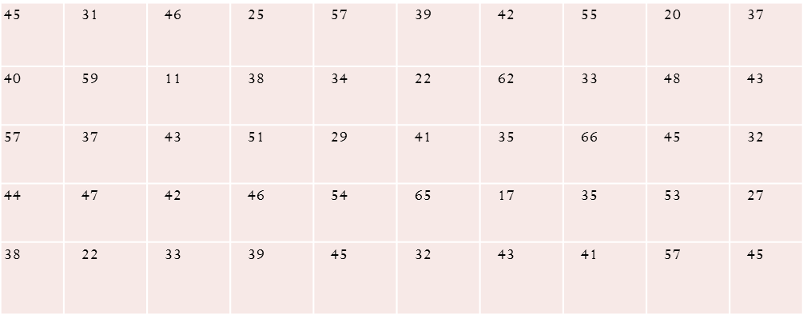
Table 1

Slide 28
It is hard to draw any conclusions about this data set in its current form.
We need to rearrange this data so that a clearer picture can be obtained.
We can achieve this by use of a histogram.
To form a histogram we need to divide the data into intervals of some convenient length and record the number of points in each interval.
We then plot the number of points falling within each interval.

Slide 29
To compute a histogram from this data set we must first find the number of intervals for the histogram and then calculate the width of each interval.
There are several ways of determining the number of intervals.
One technique, which tends to work well in practice, involves calculating the end points of the interval 2^{i-1} to 2^{i} for i ranging from 1 to the number of data points - which we will call n.
This calculation continues until the number of points in the data set is enclosed in the interval and the corresponding value of i gives the number of intervals required for the histogram.

Slide 30
Calculating the Number of Intervals
Using the data from Example 1, the number of data points is 50.
If we calculate the intervals 2^{i-1} to 2^{i} for i = 1, 2, 3 etc. until 50 is enclosed within one of the intervals, we arrive at the interval 32 to 64 (see Table 2).
The corresponding value of i is 6 and this is the number of intervals required for the histogram.
For i = 6, 2^{i-1} = 2⁵ = 32 and 2^{i} = 64

Slide 31
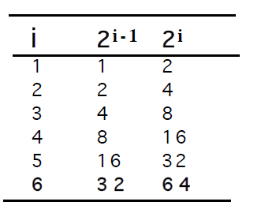
Table 2

Slide 32
Calculating the Width of Each Interval
The width of each interval is calculated as follows:
Divide the range of the data set by the number of intervals.
The nearest whole number from this calculation is the interval width for each bar of the histogram.
For this example, the range of the data set is 55 = (66-11) and the number of categories is 6.
The interval width is therefore 55/6 = 9.12 which to the nearest whole number is 9.

Slide 33
The histogram will then consist of 6 intervals each of width 9 hours.
The first interval ranges from 11 hours (the lowest value) to 20 and so on.
The Frequency Distribution (Table 3) and the Histogram (Figure 1) are shown on the following slides.

Slide 34
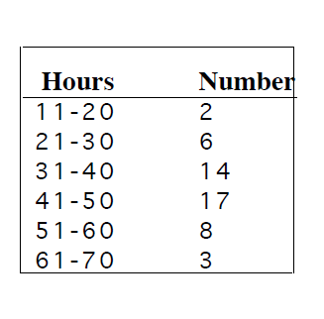
Table 3

Slide 35
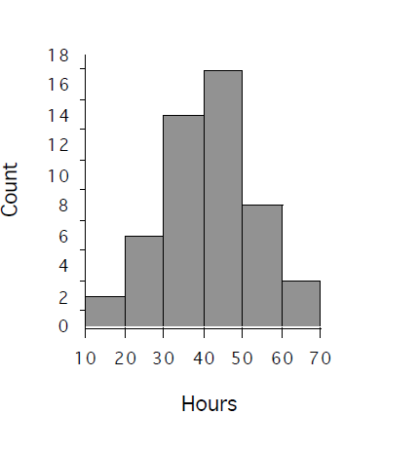
Figure 1

Slide 36
Measures of Location and Dispersion
The the mean of this data is 41 and the standard deviation is 12.3.
If we examine the data more closely, we will see that all the data values are included between the bounds of the mean plus or minus three times the standard deviation or 41 ± 37.
This is an important point which will be returned to later.

Slide 37
Discrete Data
If the data set contains just a few categories i.e. the data are discrete then a bar chart can be calculated with each bar representing a count of the numbers in each category.

Slide 38
Dot Plots
Dot plots are simple yet effective visual displays for representing the distribution of continuous data.
Individual data values are represented as points or dots on a chart.
The dot plot is most effective when the sample size is relatively small.

Slide 39
Example
The following data set is based on quotations (€ ) received from seven insurance companies for a 20 year old male with a three year no claims bonus requiring non-comprehensive cover:
2,543 3,285 2,840 2,609 2,440 3,191 2,636

Slide 40
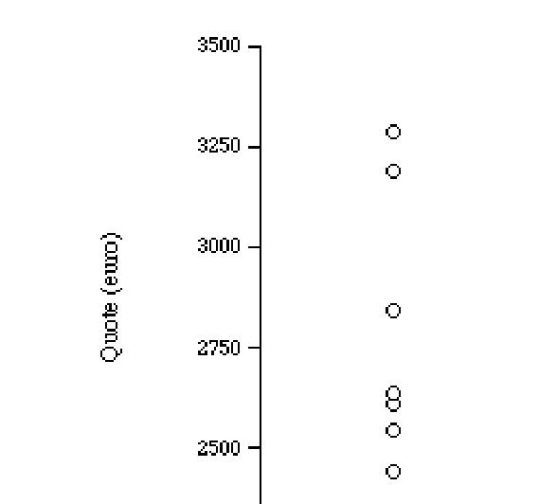
Figure 2: Dot plot of Motor Insurance Quotes
The dot plot for this data set with each data value represented as a dot or circle is shown in Figure 2 below:

Slide 41
Box-and-whisker plots allow five important components of a continuous data set to be readily visualised as shown in Figure 3.

Slide 42
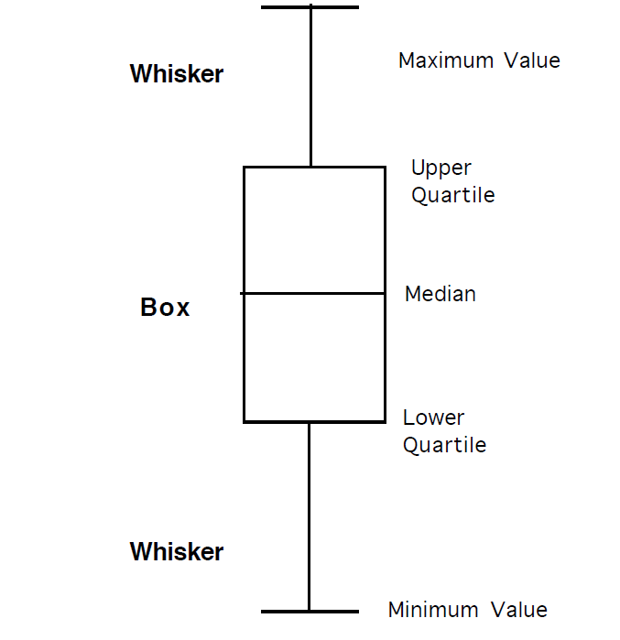
Figure 3

Slide 43
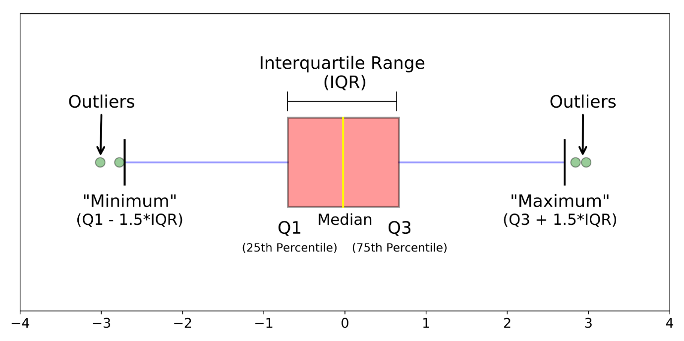
Or

Slide 44
The five quantities, sometimes referred to as five number summaries, are the maximum and minimum values, the median (50th percentile) and the upper (75th percentile) and lower quartiles (25th percentile) of the data set.
The box part of the display extends from the lower quartile to the upper quartile of the data set.
This distance is known as the interquartile range (IQR) and is used as a measure of the variability of the data set.
The whiskers extend from the upper and lower quartiles to the maximum and minimum values of the data set, respectively.

Slide 45
Example
The previous example listed the following seven quotes for non-comprehensive insurance received by a 20 year old with three years no claims bonus:
2,543 3,285 2,840 2,609 2,440 3,191 2,636
To compute a box plot the data are first sorted from highest to lowest as follows:
3,285 3,191 2,840 2,636 2,609 2,543 2,440

Slide 46
The maximum and minimum values are € 3,285 and € 2,440, respectively.
The median is 2,636.
The upper quartile is (3,191+2,840)/2 = 3,015 while the lower quartile is (2,609+2,543)/2 = 2,576.
The box plot for this data set illustrating the five figure
summary is shown in Figure 4.

Slide 47
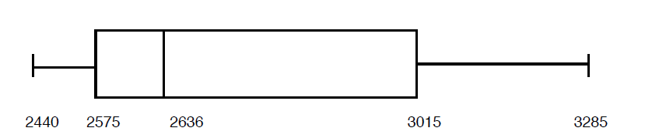
Figure 4

Slide 48
If the median line in the box is not half-way between the upper and lower quartiles we say the data is not symmetric.
We describe such a data set as skewed.
In the above plot the right part of the box is substantially larger than the left part.
We describe such a data set as right or positive skew.
If the left part of the box were larger than right part of the box the data set is described as left or negative skew.

Slide 49
Stem and Leaf Plots
Stem and leaf plots are another simple graphical display used to visualise the distribution of continuous data.
To create a stem and leaf plot each data value is split into two parts labelled the ‘stem’ and the ‘leaf.

Slide 50
Example
The following data in Table 4 are the times (in hours) as determined by the investigating Garda for a sample of 30 reported road accidents in 2000.

Slide 51
Table 4
3.8 | 21.5 | 1.3 | 10.8 | 14.5 | 21.3
18.3 | 19 | 14.5 | 12.4 | 2.8 | 0.8
22.8 | 11.8 | 10.3 | 11.6 | 7.9 | 11.3
16 | 20.8 | 12 | 19.7 | 0.3 | 21.5
19.5 | 4.3 | 0.1 | 3.7 | 15.5 | 23.5

Slide 52
To construct a stem and leaf plot the data set is organised into a single ordered column using, in this case, the hour of the accident.
This column is known as the stem.
Attached to each stem value is the recorded minute of each accident (expressed as a proportion of an hour).
This corresponds to the last digit in the data set and is referred to as the leaf component of the plot.

Slide 53
The leaf component is similar to a histogram but displays the actual data values in ranked order.
When constructing a stem and leaf plot place the sample size on the graphic together with the key i.e 1|3 meaning 1.3 hours as shown in Figure 5.

Slide 54
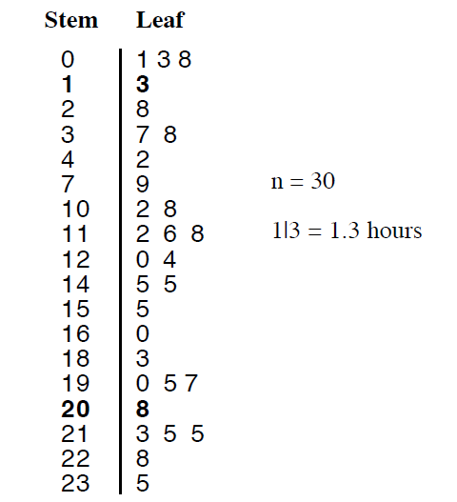
Figure 5: Stem and Leaf Plot for the Times of a Sample of 30 Road Accidents

Slide 55
The stem plot is a concise exploratory visualisation tool.
However although it can be very useful for visualising data, it may not be recognised as a visualisation!
Used by statisticians.

Slide 56
In Figure 5, the distribution of accidents by hour can be readily examined.
Even though it includes only 30 accidents from a total number of over 8,000 reported injury accidents in 2000 we can see that relatively large (10 out of 30) number of accidents occur between 9 pm and 3 am despite the fact that traffic activity is lowest during these hours.

Slide 57
This is a characteristic of Irish road accident data which is not a feature of other European countries, and is explained, to a large extent, by alcohol and/or speed by road users during these hours.
Of interest in the exploratory analysis of this small data set is the distribution of numbers in the leaf.
Why are a high proportion of numbers 0, 5, 3 and 8?
We should expect a more equitable distribution of numbers as accidents can happen at any minute during an hour.

Slide 58
The reason for the large number of 0, 5, 3 and 8 numbers is that the reporting Garda has a tendency to give the time of the accident to the nearest quarter of an hour rather than the actual time of the accident.
For example, if an accident occurred at 7:11 this may be recorded by the investigating Garda as 7:15 or 7:00.
Similarly an accident at 7:40 may be recorded as 7:30 or 7:45

Slide 59
As our data set expresses minutes as a proportion of an hour, 15 minutes is 0.3 (rounded from 0.25), 30 minutes is 0.5 and 45 minutes is 0.8 (rounded from 0.75).
This observation is of interest in road accident research work and highlights the caution required when dealing with reported data.

Slide 60
In 1997 researchers in the UK linked the impact of daylight on accident rates by using the reported accident time.
This involved a high degree of mathematical sophistication whereby the orientation of the sun at the reported accident time provided a measure of the level of daylight.
However, the study did not mention the large error between reported accident times and the actual accident times referred to above which is also a feature of UK accident data.

Slide 61
“They collect them, raise then to the nth power, take the cube root and prepare wonderful diagrams. But you must never forget that every one of these figures comes in the first instance from the village watchman, who just puts down what he damn well pleases”
[Josiah Stamp (1880-1941), Economist]

Slide 62
2. Discrete Data (Univariate)
There are fewer techniques available for the visualisation
of discrete data when compared with continuous data.

Slide 63
Bar Chart
Bar charts are similar to histograms except that bar charts are used for representing discrete rather than continuous data.
For example in Figure 6, the graph on the left is a bar
chart used for visualising discrete data.
The graph on the right is a histogram, used to visualise continuous data.

Slide 64
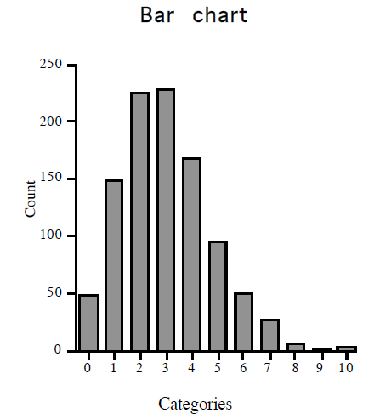
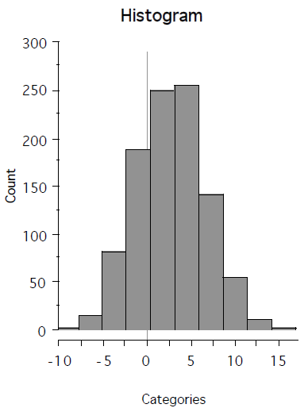
Figure 6

Slide 65
The difference between the bar chart and the histogram can be seen by reference to the x-axis.
The bar chart has only a few distinct categories with the total number of data points in each category represented as a bar.
Continuous data, on the other hand, has so many
different values that it is not practical to represent each
unique value as a bar.
Instead, the data is collected into broad categories (intervals) and the number of observations in each interval plotted with no gaps between intervals.

Slide 66
Bar Charts
Good for displaying nominal-quantitative data.
Always start the scale at 0.
True scale is required
Good for showing differences.
Do not use 3D.

Slide 67
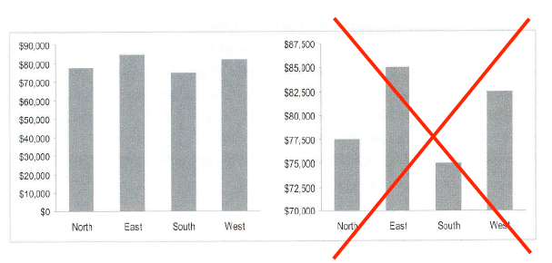
Scales

Slide 68
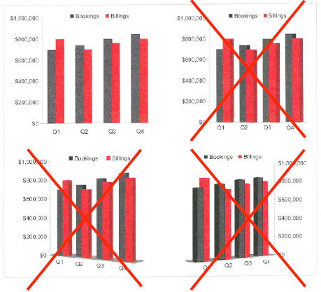
3D

Slide 69
Pareto Chart
The Pareto chart is a bar chart where the number of data values in each discrete category or bar are reordered (i.e. ranked) from highest to lowest in descending order.
Pareto charts can be very useful visual aids for summarising data and for highlighting the principal characteristics of a data set.

Slide 70
They are often used by quality engineers to illustrate that a high percentage of the quality problems associated with a manufacturing process are explained by a small number of issues.
This is sometimes referred to as the 80/20 rule whereby roughly 80 per cent of the faults in a process can be attributed to 20 per cent of all failure modes.
Presenting the information in a Pareto format allows for the prioritisation of quality improvement strategies.

Slide 71
Example 1
The plot in Figure 7a is an example of a Pareto chart used to display the type of failure mode recorded for 20,000 computers inspected at a test station located in a high volume
manufacturing process.
From the plot it is clear that the failure modes Video and CD
are the principle manufacturing problems requiring priority
attention.

Slide 72
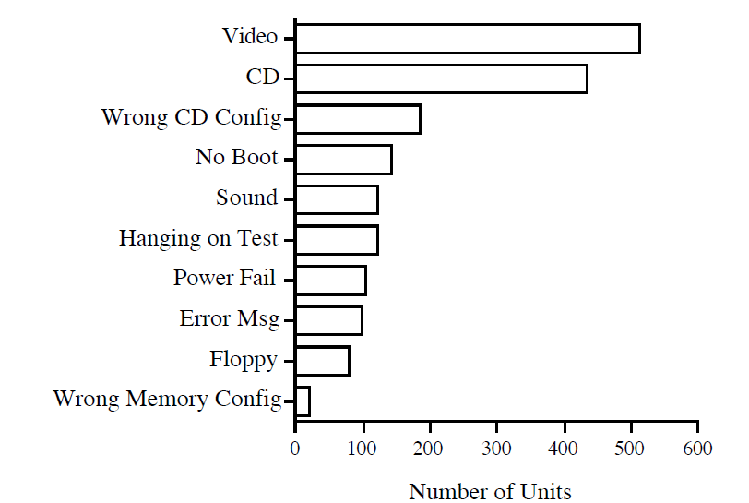
Figure 7a

Slide 73
Example 2
The plot in Figure 7b is an example of a Pareto chart used to display the occurrences of certain bottlenecks in a business process in one week.
From this plot, we can see that taking care of the first two bottlenecks: Bottleneck D and Bottleneck A will take care of around 80% of the entire defects.
The analysis would be the same if there were more bottlenecks to take care of, as the Pareto Rule of 80/20 is in play.

Slide 74
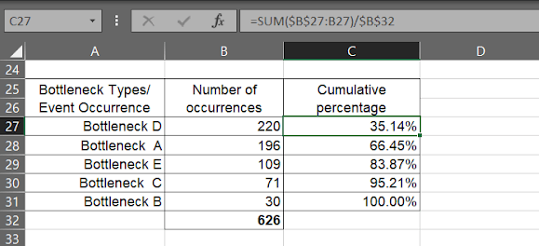
Table 5

Slide 75
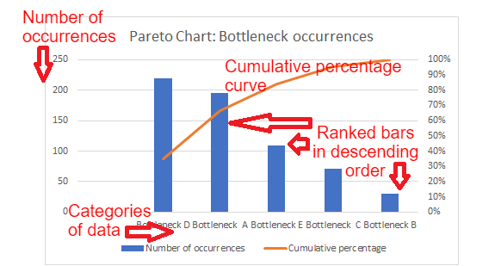
Figure 7b

Slide 76
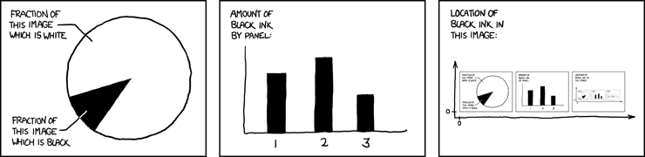
Pie Chart
http://xkcd.com/688

Slide 77
Pie Chart
Pie charts are probably the most common statistical charts used for graphing univariate discrete data but are generally regarded as poor devices for visualising data.
Pie charts are used for representing the relative frequencies associated with the observed value of a categorical (discrete) variable.

Slide 78
The pie chart consists of circles subdivided into
sectors whose size is proportional to the quantities.
They are really only suitable for percentage/proportion data.
They are often used to visualise the responses to surveys where a few categories are used e.g. yes/no/don’t know.
Do not use 3D.

Slide 79
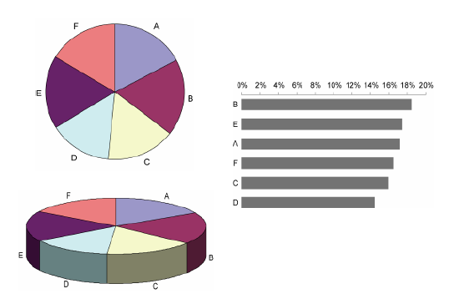
Pie Charts: Perceptually Difficult

Slide 80
Example
As part of an overall study of traffic patterns on the M50 motorway the National Roads Authority (NRA) distributed 30,000 questionnaires to motorists during a two week
period.
One question asked for the number of people in the vehicle at the time of the survey.
A total of 10,000 questionnaires were returned to the NRA and the percentage vehicle occupancy was calculated (see Table 6 ).
A pie chart of this data is shown in Figure 8.

Slide 81
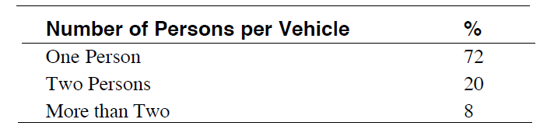
Table 6

Slide 82
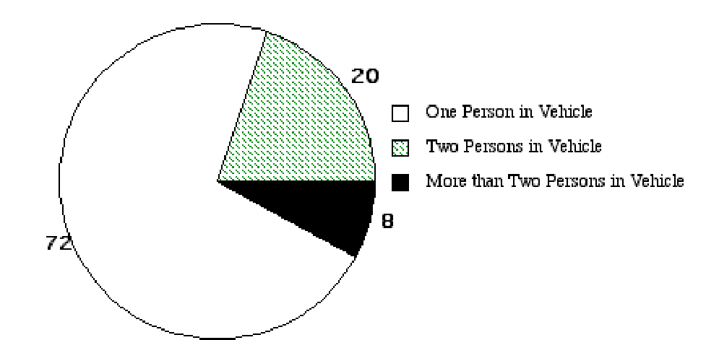
Figure 8: Distribution of Vehicle Occupancy the M50.

Slide 83
Pie charts are, in effect, the same as bar charts that we examined earlier except that bar charts are based on Cartesian co-ordinates (x,y) whereas for pie charts the data are transformed to polar co-ordinates (r, ϕ).

Slide 84
Pie Charts Disadvantages
The Pie chart has several drawbacks as a visualisation tool.
Firstly they force us to make an angular comparison
The human eye cannot perceive areas very well so comparative assessment of the magnitude of the different slices is difficult (see aside on following slides).

Slide 85
Aside: Psychophysics
This arises because the perceived magnitude of the slices
are not a linear function of the actual values (Figure 9).
This is true of a range of stimuli including perceptions of shock or taste and is the basis behind the field of psychophysics (coined by the German biologist and physicist Gustav Theodor Fechner).

Slide 86
JND
The theory of psychophysics is built on the term just-noticeable-difference (JND).
The JND is the change in magnitude of a stimulus needed to produce a JND in sensation.
This effect was determined by the German, scientist Ernst Heinrich, to be a constant.

Slide 87
Example
If a kilogram of weight is placed on each of your two hands you should perceive no difference in weight between the two.
If more weight is added to only one hand you will only notice the difference in weight between the two hands after an extra
0.1 kilograms or 10 per cent is added to one hand.

Slide 88
Similarly, if you place 10 kilograms of weight on both hands it is only after an extra one kilogram (10 per cent) is added to one hand will the extra weight be perceived.
The 10 per cent threshold differs for individuals and for different stimuli but is generally constant within an experiment.

Slide 89
A plot of psychophysical functions for length and area functions is shown in Figure 9.
The graph plots intensity of the stimuli on the x-axis while the perception of the stimuli or sensation is plotted on the y-axis.
Intensity can be regarded as actual data whereas sensation can be interpreted as the individuals perceived magnitude of the data.

Slide 90
Length
From the plot the relationship between length and the perception of length is one to one.
This means that graphs using a length attribute (e.g. bar or line charts) are more effective for visualising the relative magnitudes of different categories.

Slide 91
Area
For area attributes, the relationship between data and perception is non-linear suggesting a differential between actual and perceived magnitudes.
For example, from Figure 9 an intensity of 5 units
(actual data) produces a sensation or perception of just over
3 units.
Also note that when designers adjust diameter rather than area to match the data, more problems are created.
See example on following slides.

Slide 92
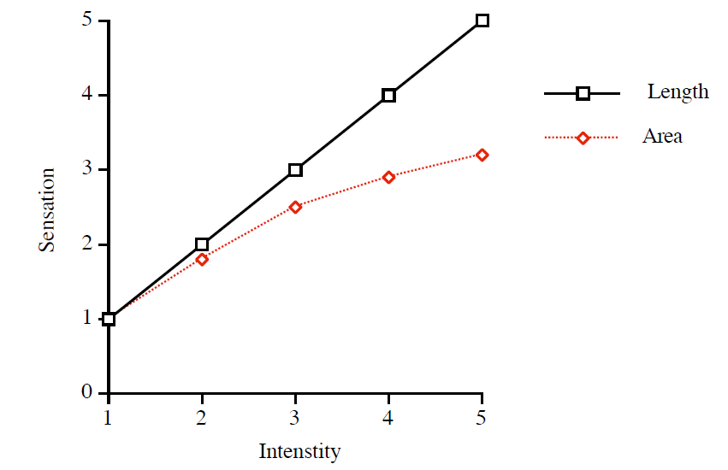
Figure 9: Psychophysical Functions for Length and Area Stimuli

Slide 93
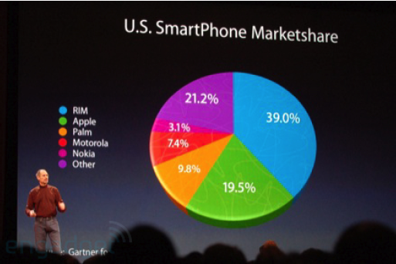
End of Aside: Apple Example

Slide 94
Apple get the advantage of the presentation distortion.
Also, our eyes are better at perceiving green than the bordering colours.
Inclusion of numbers is good
However they force us to do the math.
Thus we lose the advantage of the visualisaion.

Slide 95
Pie Charts Disadvantages
Another disadvantage of pie charts is that they are only suitable for representing a small number of distinct categories.
For example, plotting the number of pedestrians killed in Ireland by month between 1988 and 1999 in Ireland as a pie chart as shown in Figure 10.

Slide 96
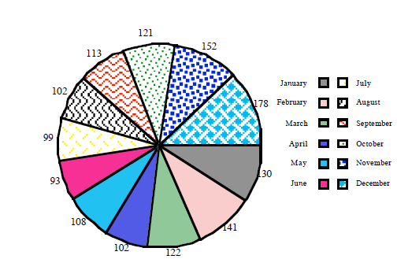
Figure 10: Pedestrians Killed in Ireland Classified by Month, 1988-1999

Slide 97
This graphic produces a cluttered image of 12 sectors representing the 12 months of the year.
It is very difficult to visualise the monthly variation in accidents from this chart.
In contrast the alternative bar chart representation in Figure 11 allows the monthly variation in fatal accidents and a striking U shape to be readily viewed.

Slide 98
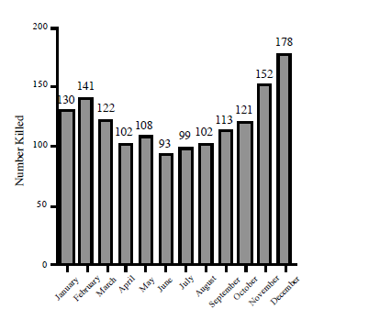
Figure 11: Pedestrians Killed in Ireland Classified by Month, 1988-1999

Slide 99
One further difficulty with pie charts is that it is difficult to compare subgroups.
For bar and line charts we will see that it is possible to compare two or more subgroups using stratified or grouped line or bar charts.
However, there is no easy way of computing a pie chart that allows for comparisons between groups.
The solution in this case is to compute a different pie chart for each group and visually compare the respective slices in each group.

Slide 100
Example
For example, the M50 survey data in Table 5 was based on the number of persons per vehicle during two time periods - morning peak hours from 7:30 am to 9:30 am and morning off-peak hours from 10:30 am to 12:30 pm.
It is of interest for traffic planners to compare the distribution of persons per vehicle for the two time periods.
This comparison is represented below using two pie charts in Figure 12.

Slide 101
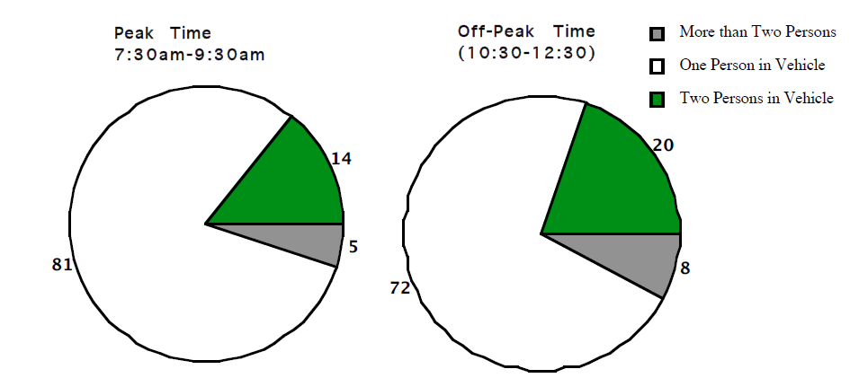
Figure 12

Slide 102
However a stacked bar chart provides a more efficient comparison between peak and off -peak distributions as shown in Figure 13 (see later in course).
Note that in Figure 13, as well as using less space, the eye is not jumping from one side of the page to the other.

Slide 103
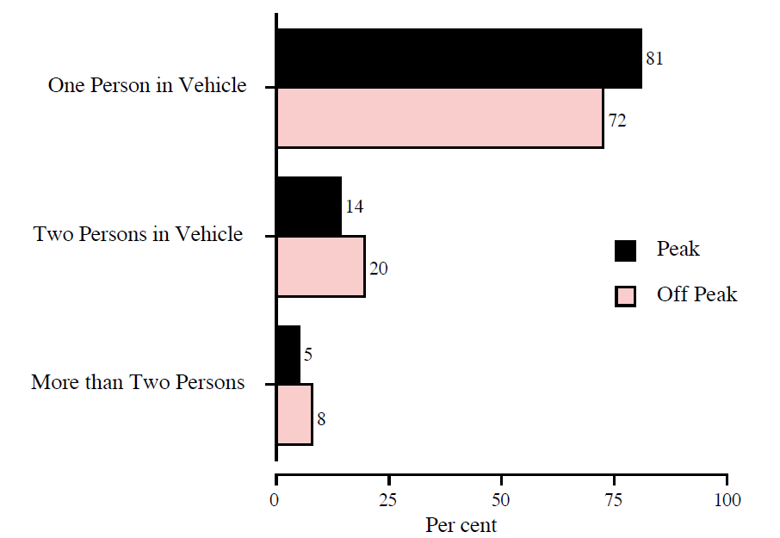
Figure 13

Slide 104
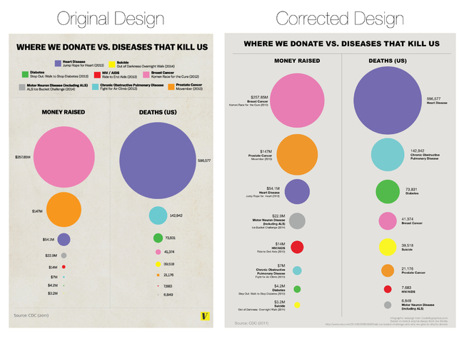
Area Example Where We Dontate vs Diseases that Kill Us
Notes:
(http://www.coolinfographics.com/blog/2014/8/29/false-visualizations-sizing-circles-in-infographics.html).

Slide 105
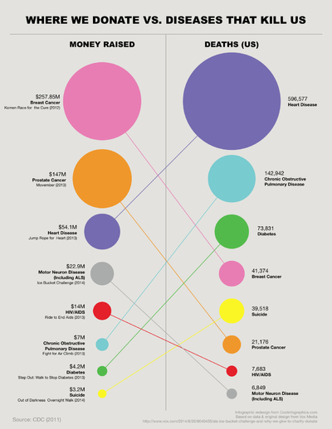
Improvements 1

Slide 106
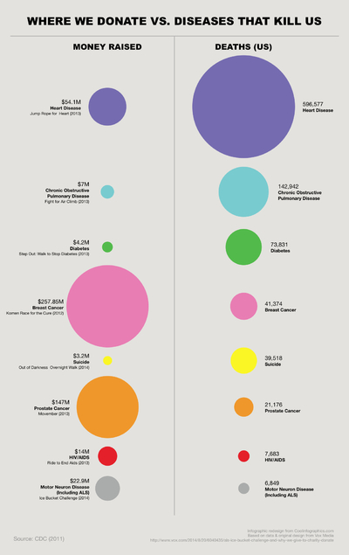
Improvements 2
Notes:
To calculate area – see ‘area versus diameter example – statistical graphics examples 1’

Slide 107
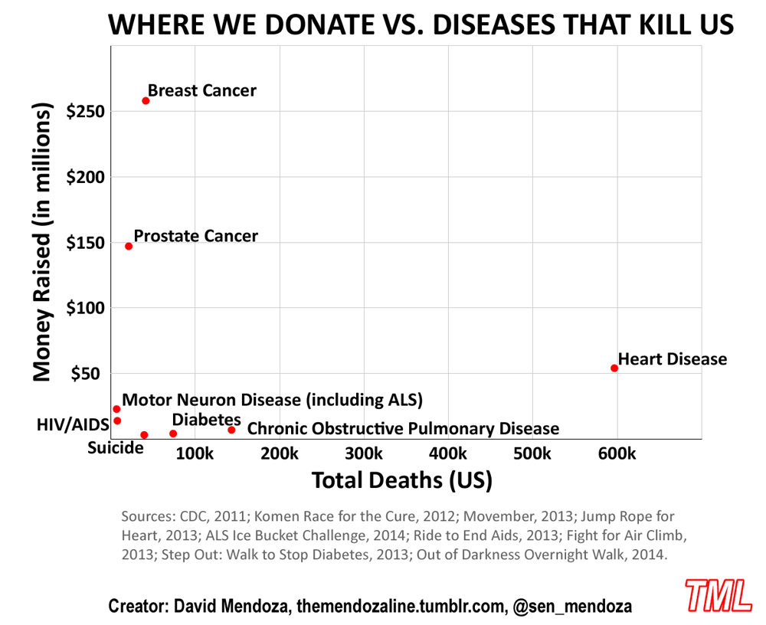
Improvements 3
Notes:
https://themendozaline.org/post/95757674381/12

Slide 108
3. Both Variables Continuous (Bivariate)
The most common tool to visualise a dataset containing two continuous variables is a scatterplot.
This is a 2-dimensional graph that is used to investigate the relationship between two continuous variables.
To draw a scatterplot one of the variables is plotted on the x-axis while the other variable is plotted on the y-axis.

Slide 109
Each point on a scatterplot represents the x and y value for each data pair. The points on the plot are not joined by lines.
Scatterplots are one of the most extensively used statistical graphics and are usually the first step taken when investigating the relationship between two variables.

Slide 110
Scatterplots
Excellent at showing the data.
Particularly good at showing the distribution.
Statistics (mean, correlation, deviation, etc.) do not tell the whole story.
Trend lines can be useful.
We can use a linear regression tool to find the trend lines.
“May be too complex for the average reader”.
Anecdotal quote from a designer at NYT.

Slide 111
Example
A scatterplot of the age of drivers involved in road accidents in Ireland between 1996 and 2003 (Age 1) and the age of the front seat passengers (Age 2) is shown in Figure 14.
From the plot it is clear that there is a general relationship between the age of driver and passenger.
That is, as the driver age tends to increase the passenger age also increases.

Slide 112
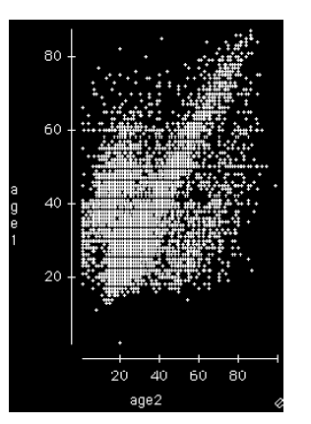
Figure 14

Slide 113
Regression and Correlation
To generate a scatterplot most computer software applications require that the two variables (i.e. the x and y variables) are entered as two separate columns.
The statistical technique simple linear regression is generally used to model mathematically the relationship between two continuous variables while the correlation coefficient, r measures the strength of the relationship.
One of the assumptions underlying the calculation of r is that there is a linear relationship between the two variables.

Slide 114
Regression Definition
Regression models describe the relationship between variables by fitting a line to the observed data.
Linear regression models use a straight line, while logistic and nonlinear regression models use a curved line.
Regression allows you to estimate how a dependent variable changes as the independent variable(s) change.

Slide 115
Simple Linear Regression
Simple linear regression is used to estimate the relationship between two quantitative variables. You can use simple linear regression when you want to know:
How strong the relationship is between two variables (e.g. the relationship between rainfall and soil erosion).
The value of the dependent variable at a certain value of the independent variable (e.g. the amount of soil erosion at a certain level of rainfall).

Slide 116
Example
You are a researcher interested in the relationship between income and happiness. You survey 500 people whose incomes range from $15k to $75k and ask them to rank their happiness on a scale from 1 to 10.
Your independent variable (income) and dependent variable (happiness) are both quantitative, so you can do a regression analysis to see if there is a linear relationship between them.

Slide 117
Line (or Run) Plots
If data have been collected over time and the time has been recorded then it is possible to plot the data as a line or run plot.
Line plots can reveal surprising trends and patterns which may otherwise remain hidden in a data set.

Slide 118
To plot data as a line plot arrange the data into two columns.
One column will hold the data which is plotted on the y axis and the other the time of measurement (which we can regard as a continuous variable) which is plotted on the x axis.

Slide 119
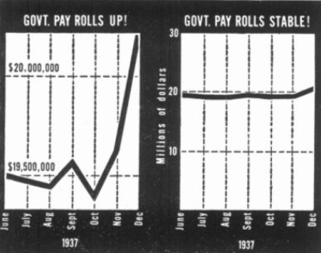
Scales – Which Graph Tells the ‘Truth’?
Notes:
Darrell Huff how to Lie with Statistics

Slide 120
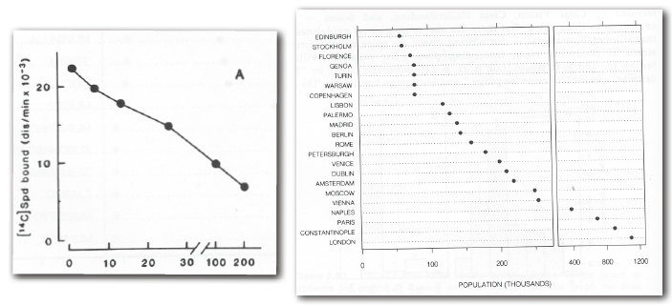
Scale Breaks
For y-axis, use full scale where possible
If the scale must be ‘broken’, make it very clear to the reader

Slide 121
(Semi-) Log Scales Definition
A semi-log graph or semi-log plot is a way of visualizing data that are related according to an exponential relationship.
One axis is plotted on a logarithmic scale.
This kind of plot is useful when one of the variables being plotted covers a large range of values and the other has only a restricted range
the advantage being that it can bring out features in the data that would not easily be seen if both variables had been plotted linearly.

Slide 122
(Semi-) Log Scales
Can solve scale-break problems
To fit everything into a small space without the need for scale-breaks
Easier to compare all the data
Compared to a scale-break
Most tools allow us to switch between
Both linear- and log- scales are valid
Linear shows absolute changes
Log shows percentage changes.
Sometimes necessary to fit data within the graphic.

Slide 123
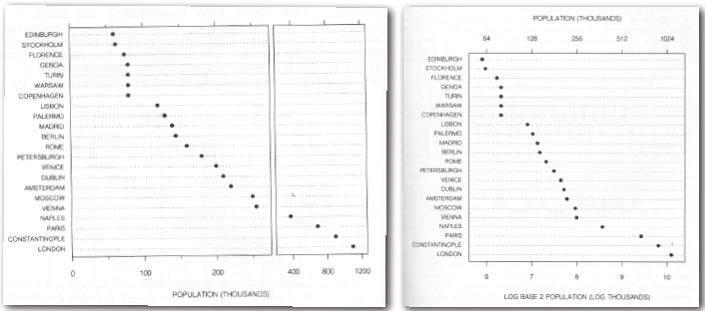
(Semi-) Log Scales

Slide 124
Example
The data set in Table 7 contains 100 measurements of the paste height (in mm) of PCB (printed circuit) boards measured before they are passed onto the next stage of the process in a computer manufacturing facility.
The data are collected in time order as indicated by the arrows below i.e. 13, 13, 13 etc.
Notes:
A printed circuit board (PCB) mechanically supports and electrically connects electronic components using conductive tracks, pads and other features etched from copper sheets laminated onto a non-conductive substrate.

Slide 125
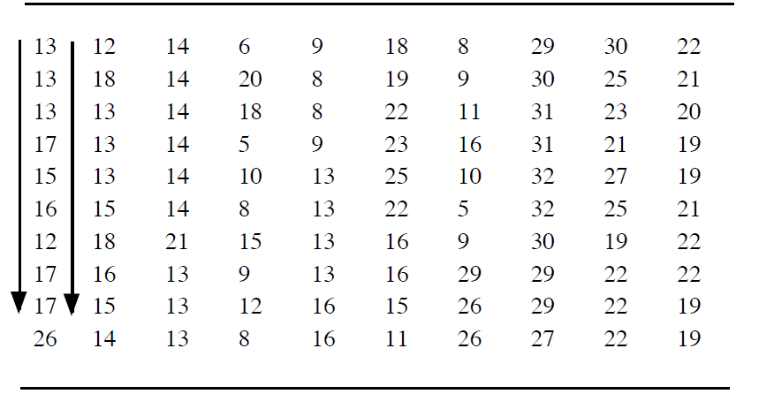
Table 7

Slide 126
Plotting the data as a run plot we can clearly see that the process has shifted upwards from about point 70 as shown in the graphic in Figure 15.

Slide 127
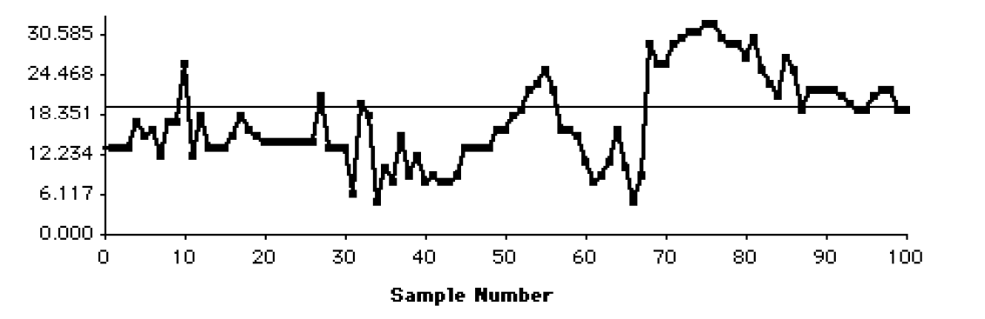
Figure 15

Slide 128
However, plotting the data set as a histogram as shown in Figure 16 it is clear that this shift in the process that occurred at about sample 70 would not be detected.
This example shows the importance of collecting the time at which the data is recorded in addition to the data itself when visualising these types of processes.

Slide 129
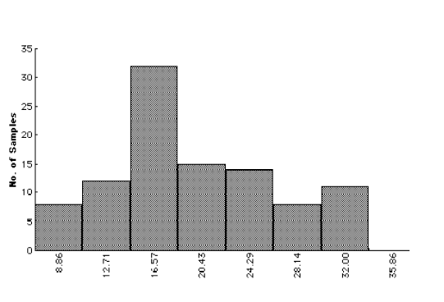
Figure 16

Slide 130
Statistical techniques for modelling line plots include Time Series Analysis and Statistical Process Control (SPC). Advanced experimental designs which incorporate measurements taken over time are known as Repeated Measures Designs.

